Slide 1
Background
Thanks to the rapid advance of networking technologies, a number of objects are being connected to Internet (ex. IoT)
loT systems have to be implemented tight access control
However, traditional centralized access control schemes have crucial issue
When adversaries hack centralized access control schemes, they can rewrite the user information and pretend to be someone they are not

Slide 2
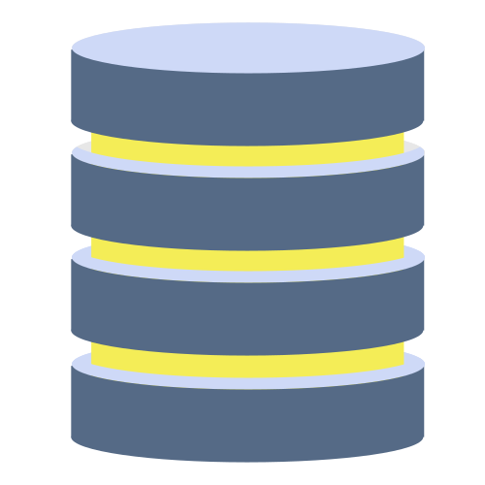
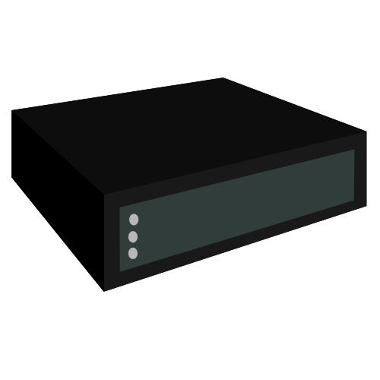








Purpose
We propose distributed access control schemes
storage
server
adversary
P2Pnetwork
User device
Smart house

Slide 3
Originality
We use blockchain to achieve distributed access control schemes
Prevent adversaries to rewrite stored data
It is possible to manage data collectively
storage
server
blockchain
adversary
P2Pnetwork
User device
blockchain
blockchain
Smart house

Slide 4
Challenging
Incentive design for miner
Blockchain network is supported by miners. they receive incentive as reward.
It is needed to design incentive
To keep data secret
Usually, data must be kept secret but blockchain keep data open

Slide 5
Project Member

Slide 6
Research Plan
June~Aug
スマートコントラクトの理解
関連論文を読む
Sep~Nov.
機能の実装
検証
Dec~Feb
テスト
発表の準備

